Slide 1

AGURI BRAND & PASCAL IMITATION JEWELRY
T2207E – SEM 1 – GROUP 2
12.2022

Slide 2

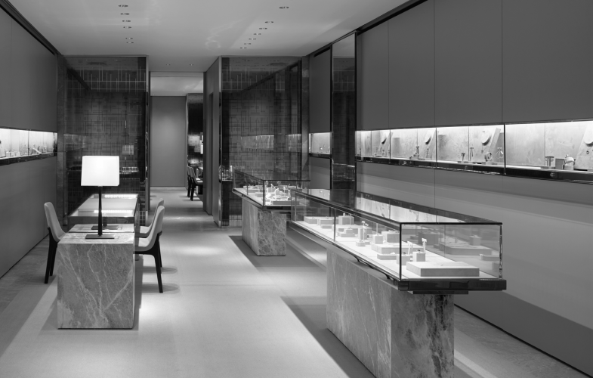
About us
“PASCAL IMITATION JEWELLERY” is one of the leading manufacturers and suppliers of Precious, Semi precious and Artificial Jewelry. They sell them under different brand names. The Quality of the products are renowned for striking features such as smooth polish, stunning design and excelling clarity, look and feature, luster. The shop owner wishes to have the website of the jeweler shop where in they want to describe all the type, brands of the product.

Slide 3




Our team

Slide 4
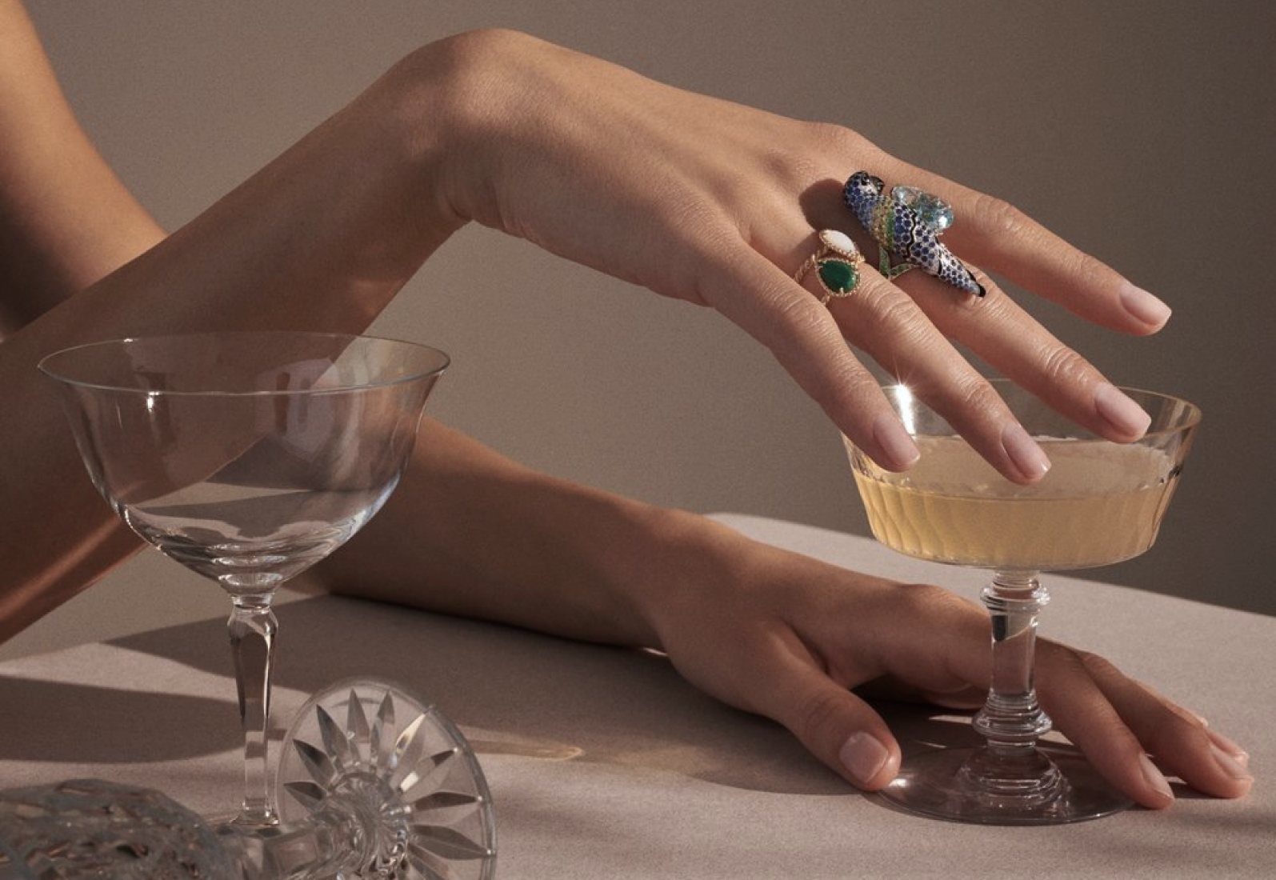
Implementation Environment
(1) HTML5/ CSS/ TypeScript
(2) Boostrap / Jquery
(3) Node JS
(4) MySQL

Slide 5
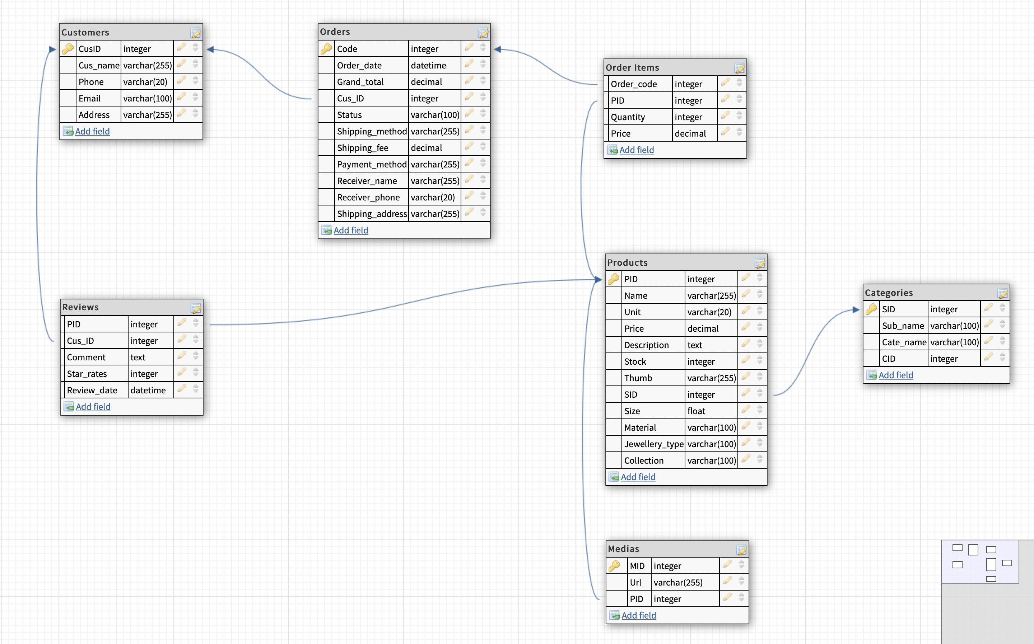
D b d I a g r a m

Slide 6
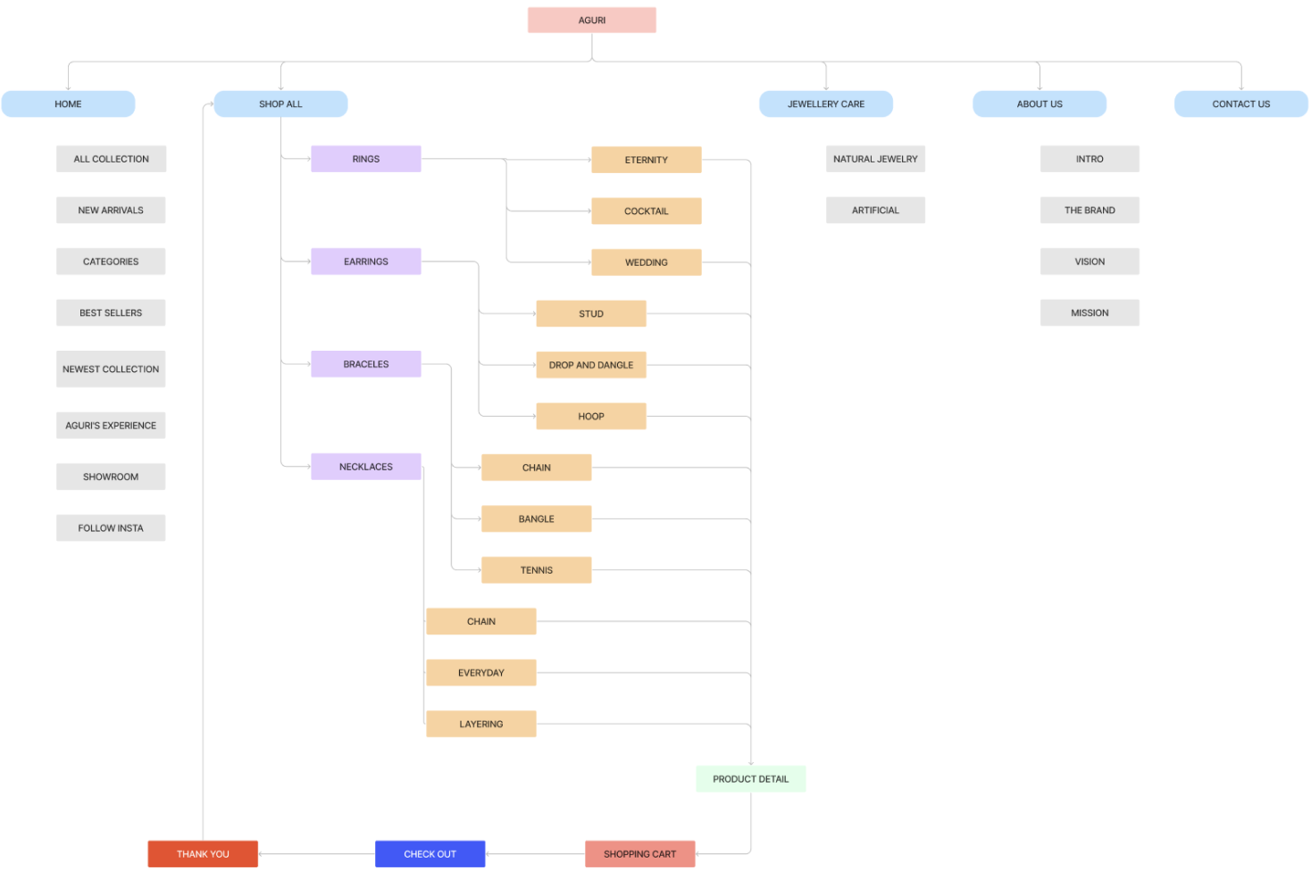
S I t e m a p

Slide 7
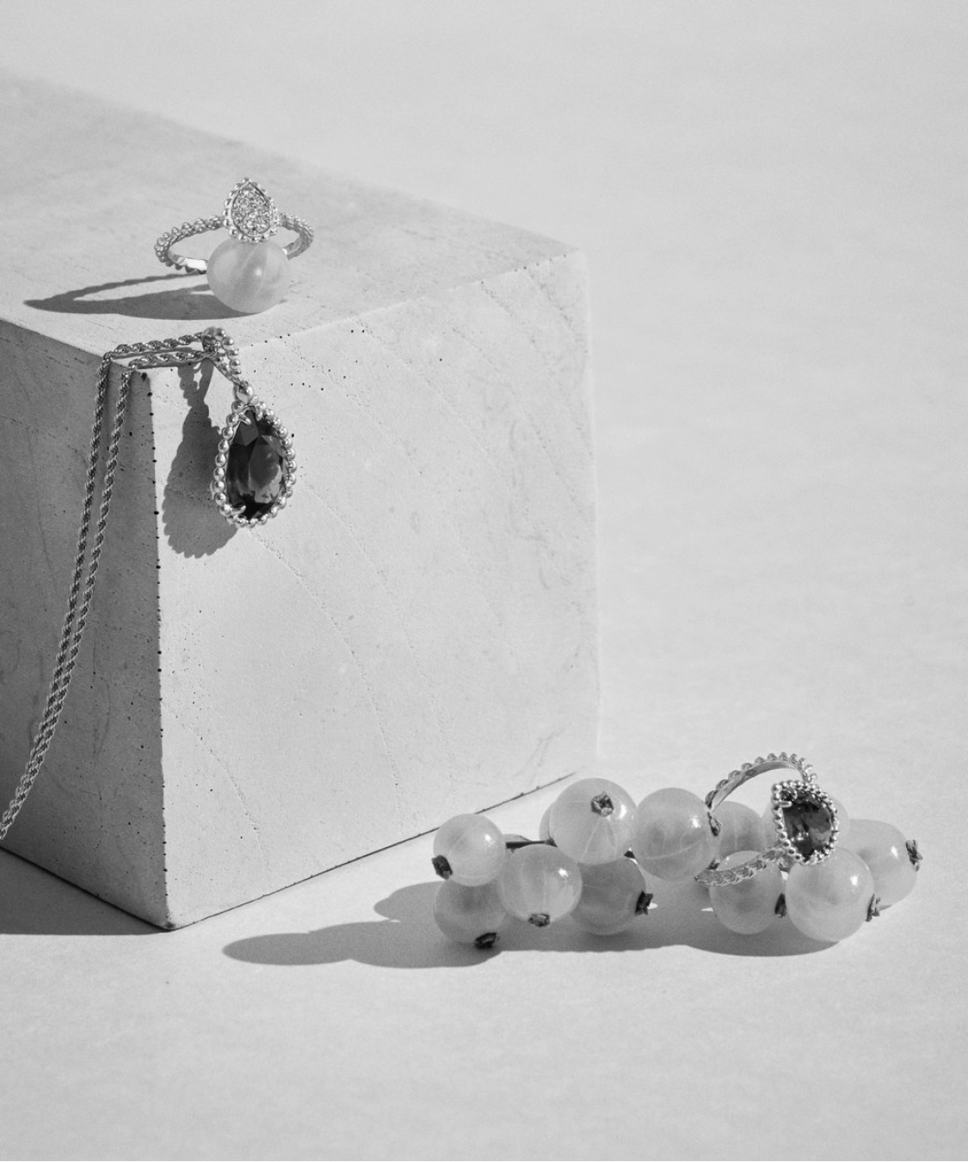
Functions
AGURI
Collection
New
Arrivals
Categories
Best
Sellers

Slide 8
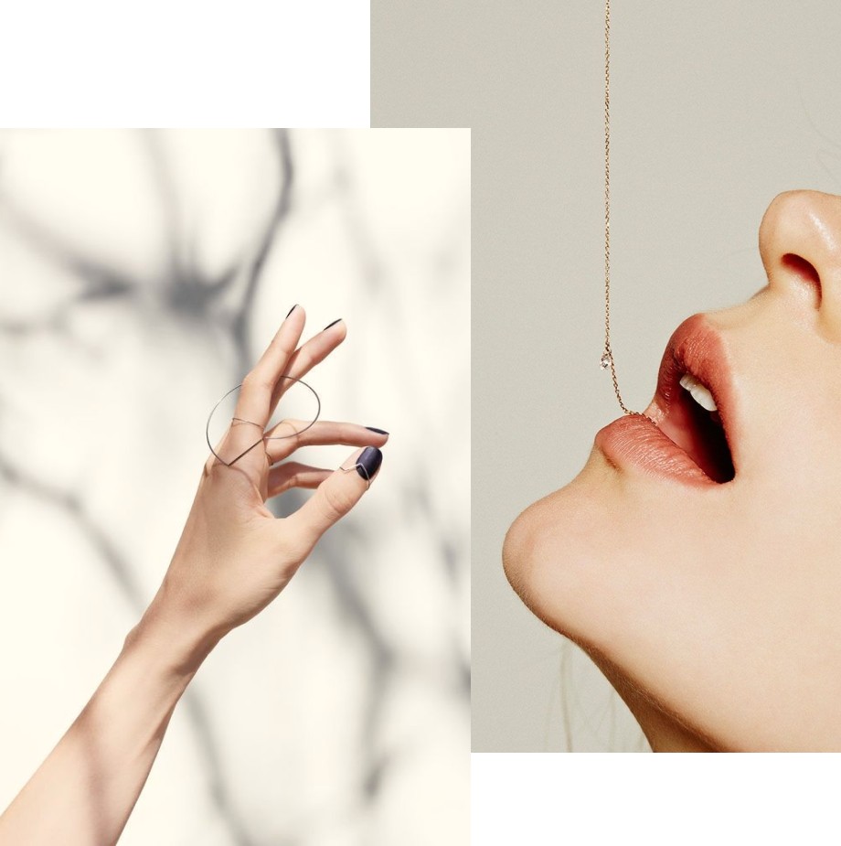
Products
Search
Quick view
Compare
Add to Cart
Detail

Slide 9
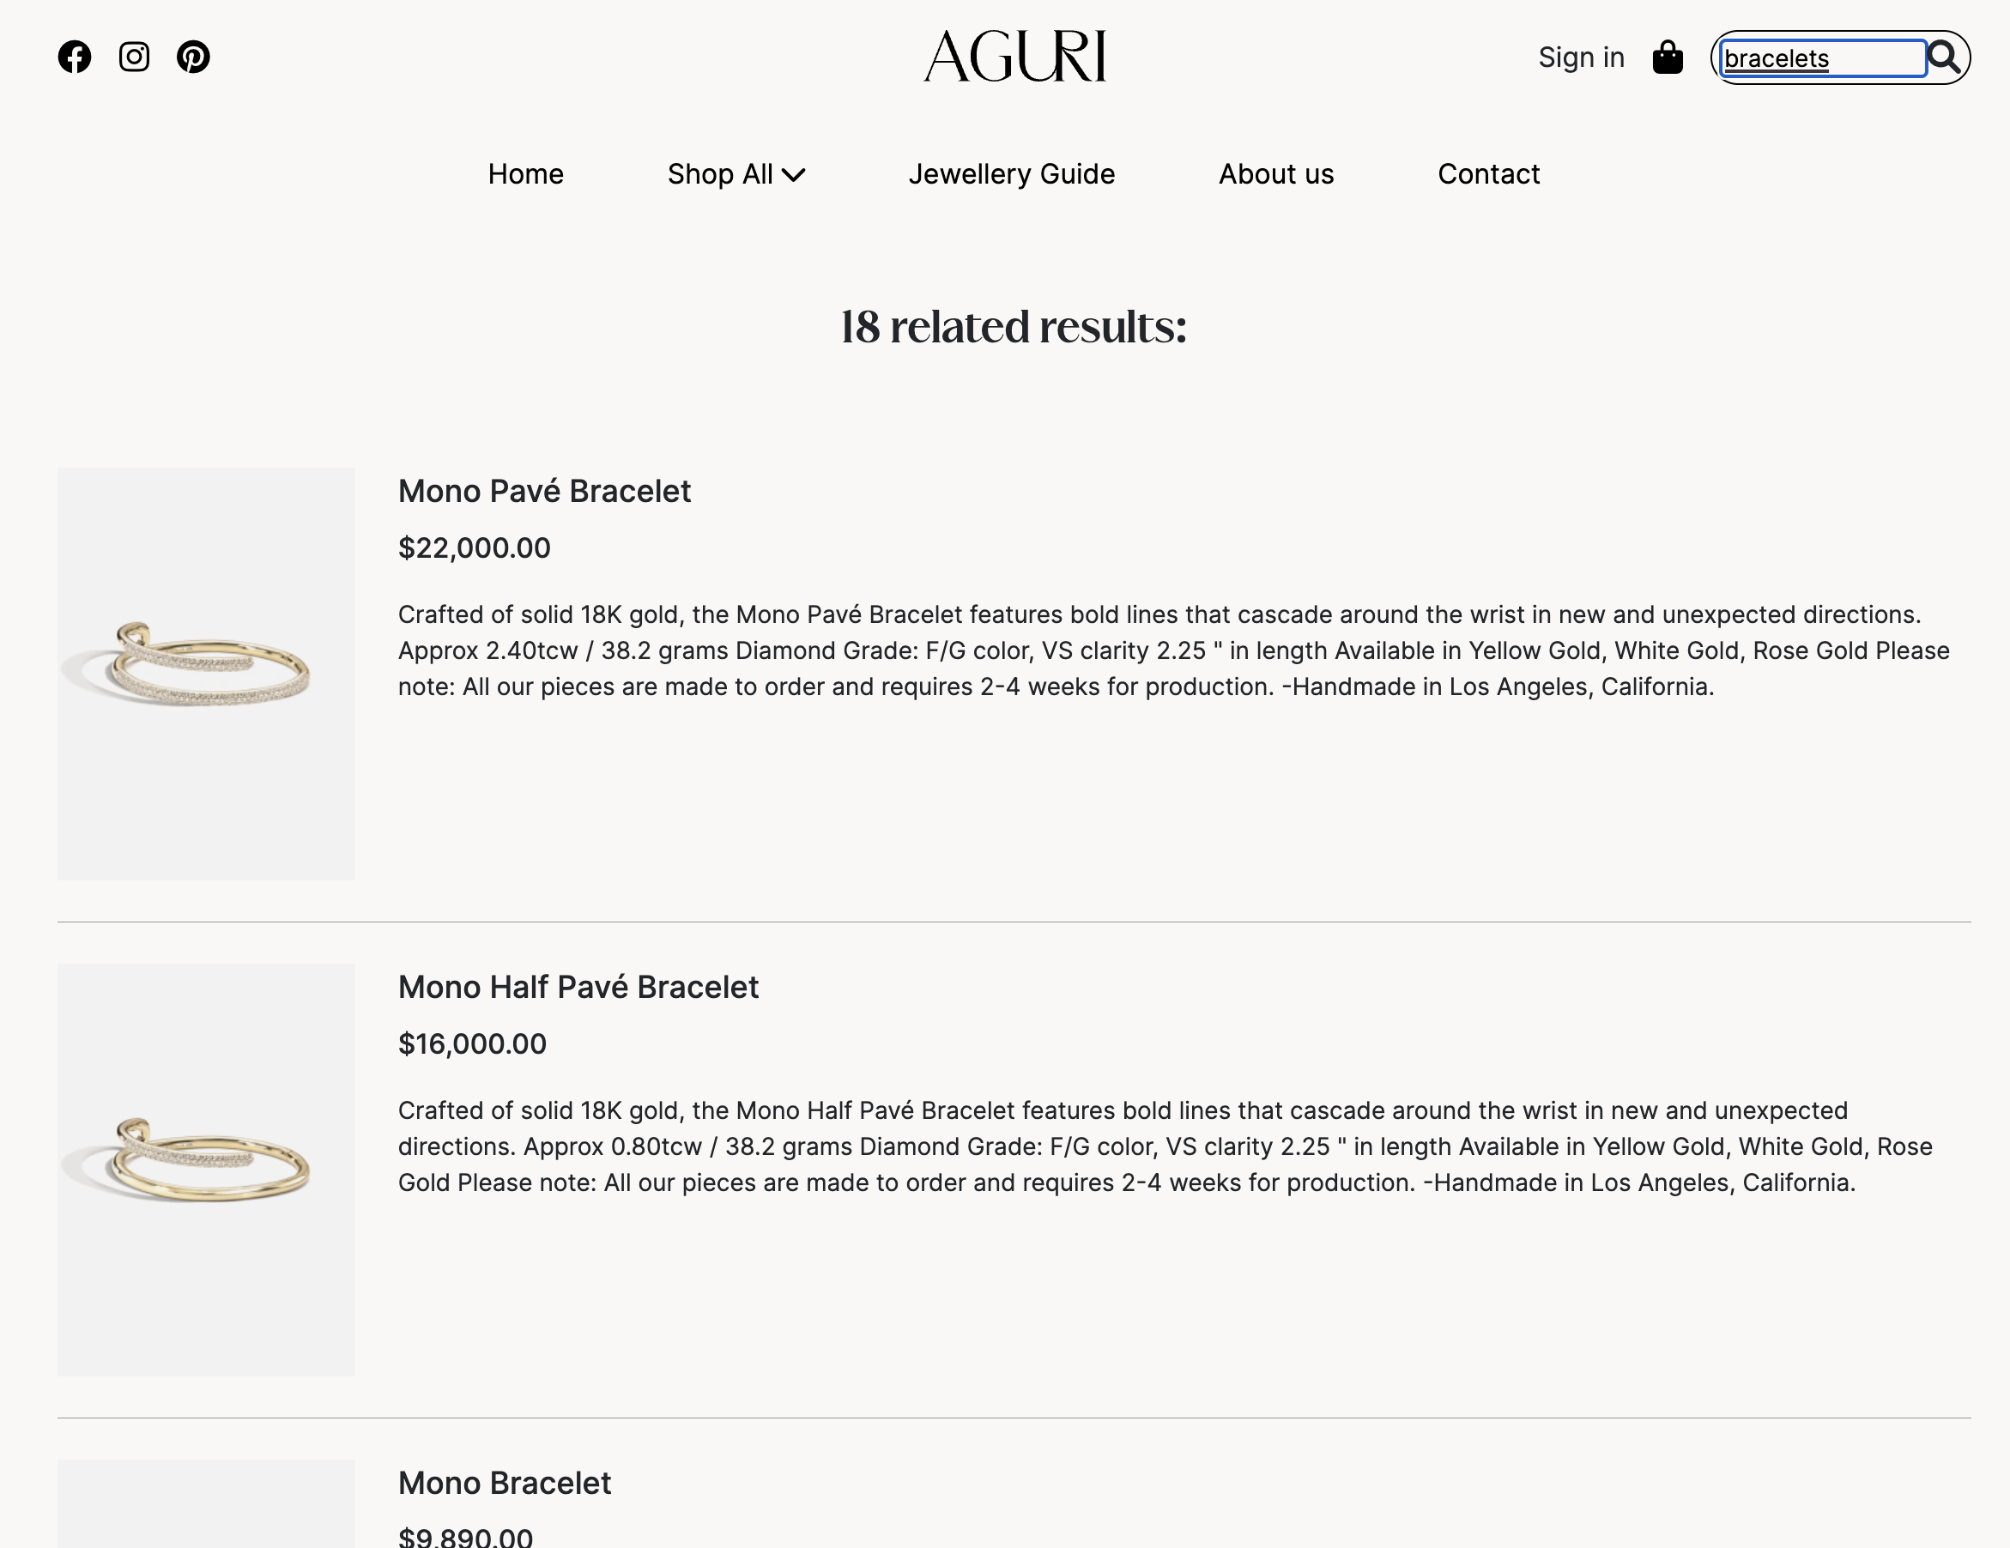
product searching
Searching allows customers to find certain products that satisfy a set of criteria. In the Aguri Brand, we implemented searching simple. Simple searches allow a customer to search the catalog for keywords.

Slide 10
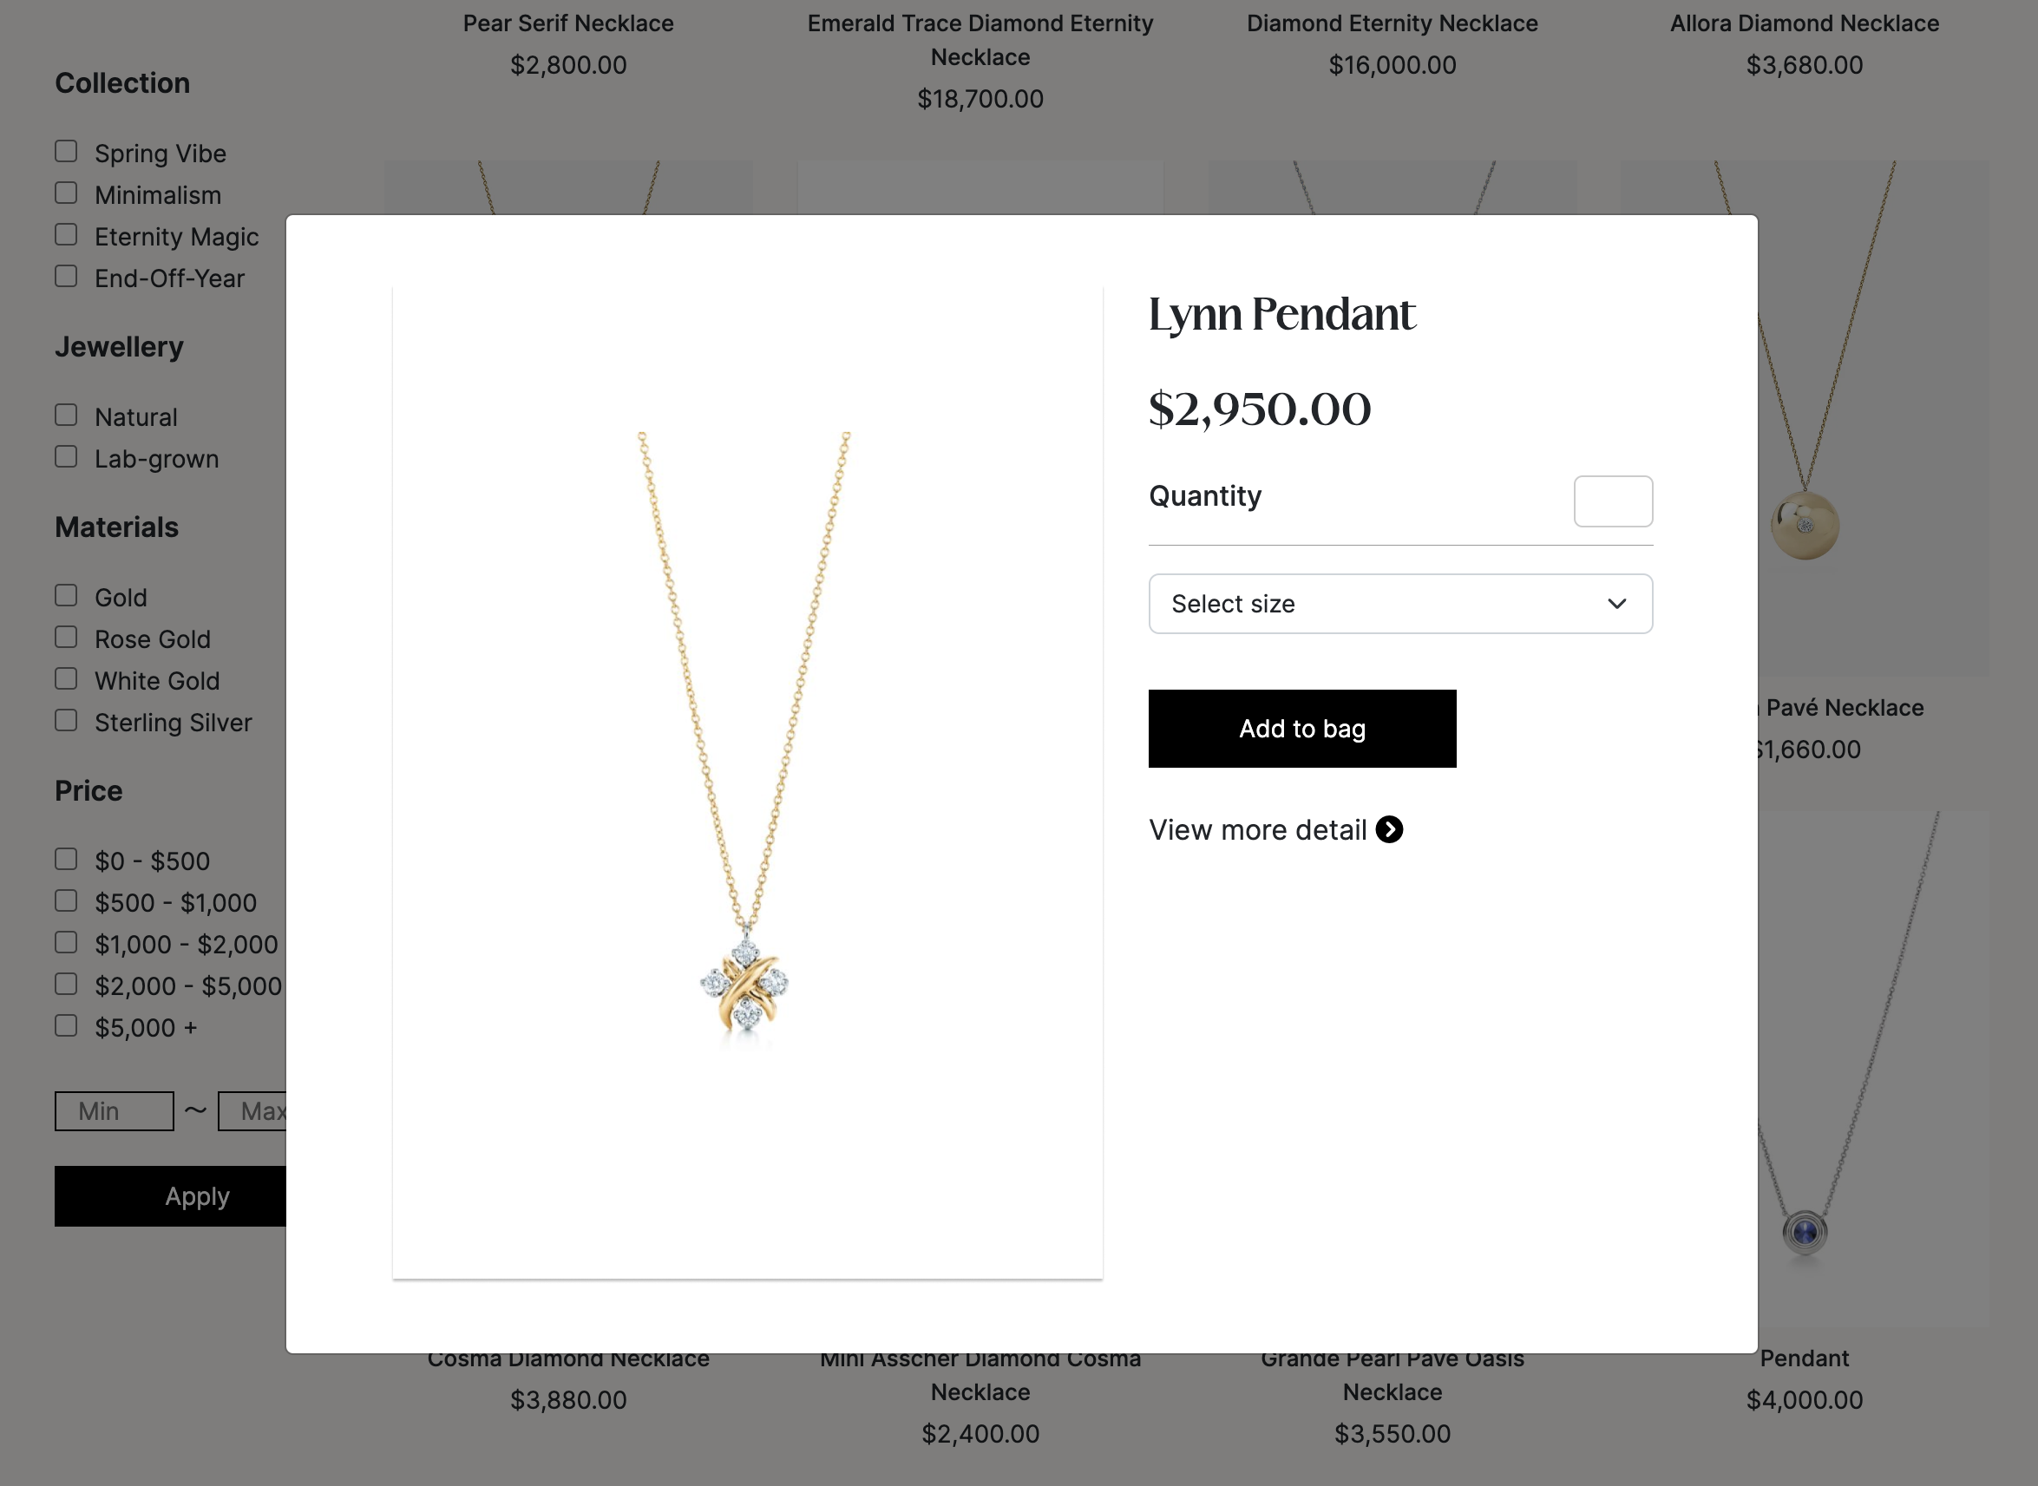
Quick view
The quick view feature makes it easier for your customers to view the key product information such as features, images, and variants by displaying a brief overview without heading to the product details page.

Slide 11
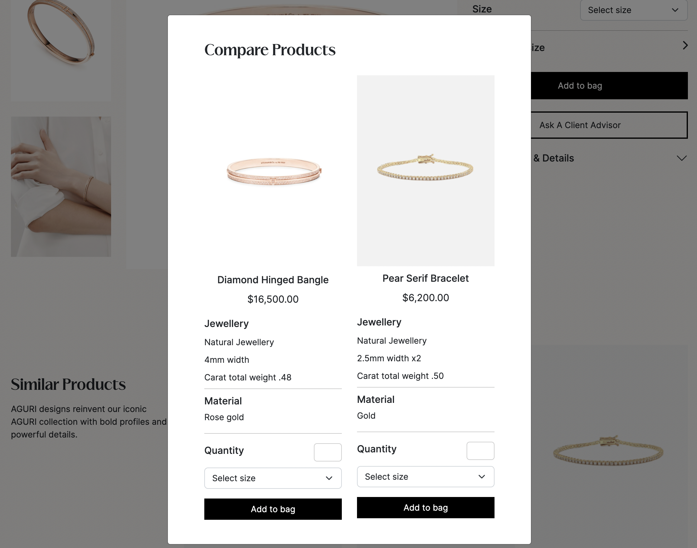
Compare products
The compare products feature makes it easier for your customers to compare the similar product information such as material, image, and variants by displaying overview without heading to the product details page.

Slide 12
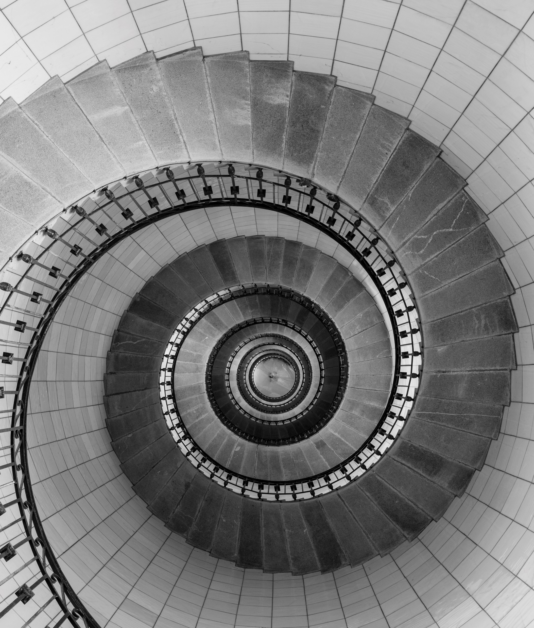
THE STAR OF THE SHOW
When you want a more elegant approach, the dynamic presence of PANTONE Very Peri shines as the star of the show in this palette of classics and neutrals whose understated stylishness conveys a message of timeless sophistication.

Slide 13

AMUSEMENTS
Use this color palette when you want to tell a joyous and whimsical story. In this palette, PANTONE Very Peri injects a sense of playful freshness into the design, exuding a good-natured warmth that quickly engages the eye.

Slide 14
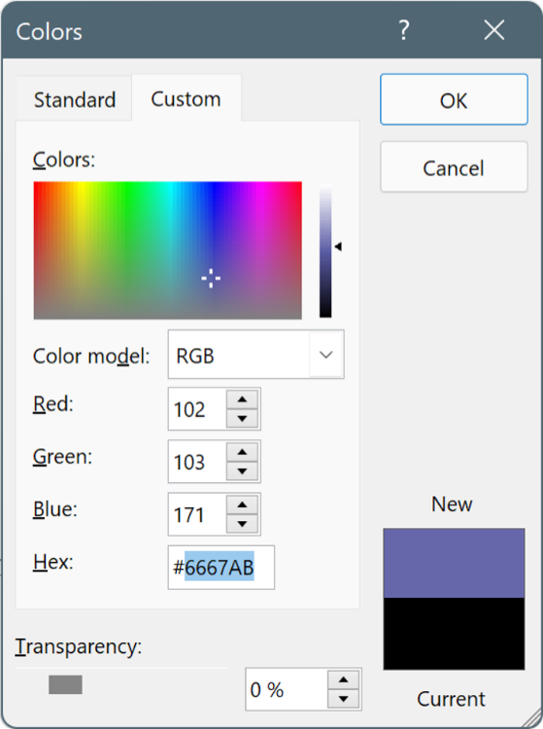
USE THESE COLORS IN ANY POWERPOINT PRESENTATION
Select a shape or text box border. When you do that, the Shape Format tab appears.
On the Shape Format tab, select Shape Fill > More Fill Colors.
In the Colors box, select the Custom tab.
Enter the Hex value of the color you want to use.
Tip: To change multiple shapes or text boxes, click the first shape or text box, and then press and hold Ctrl while you click the other shapes or text boxes.

